Slide 1

sbmlutils
Python utilities for SBML

Slide 2
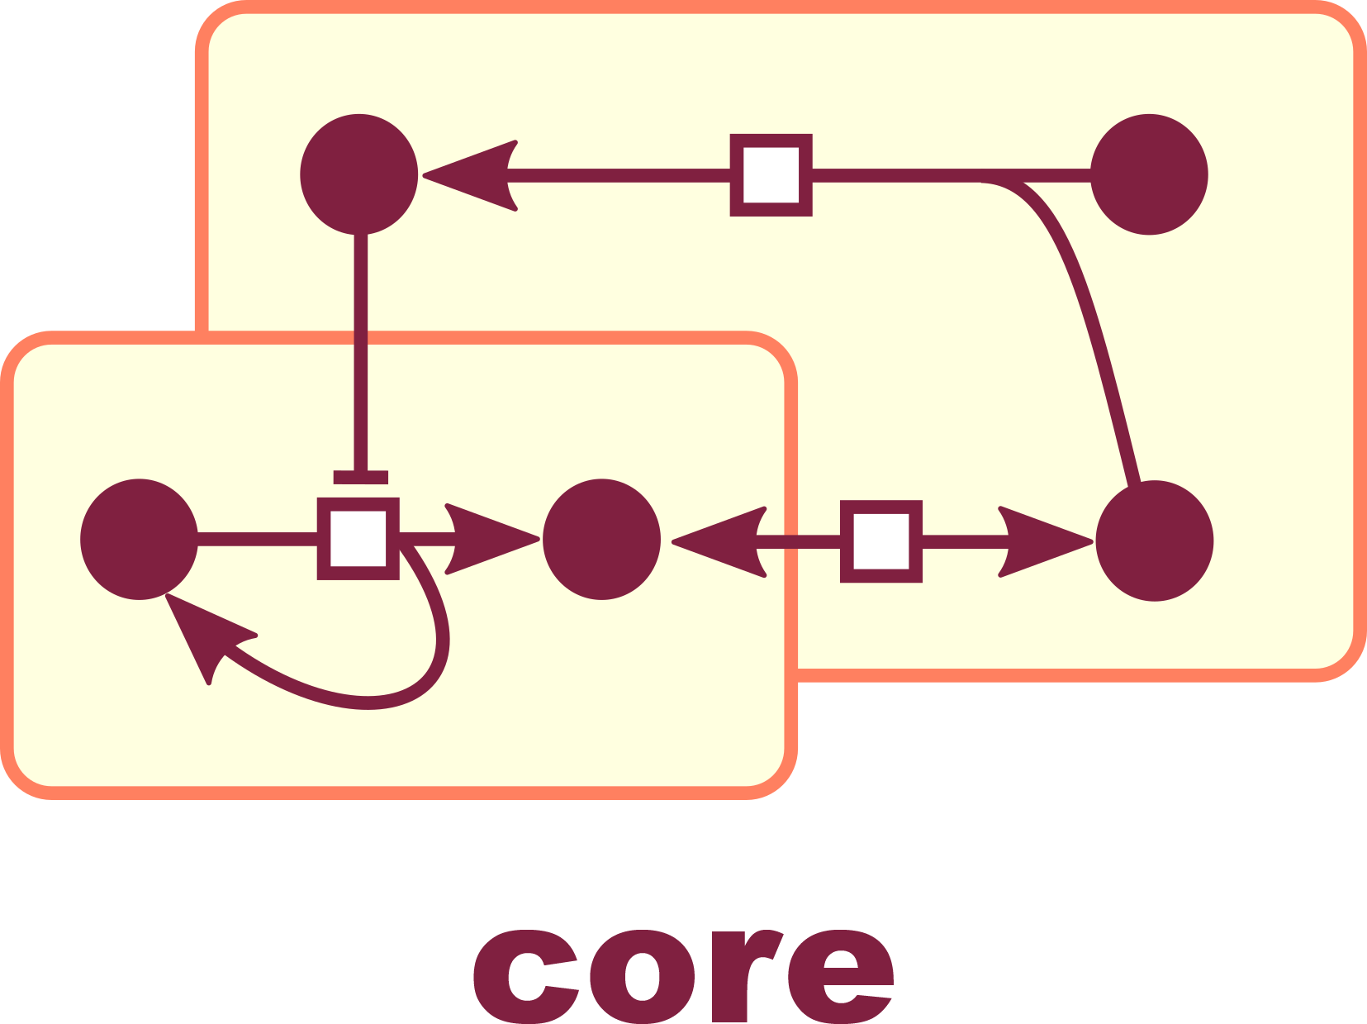
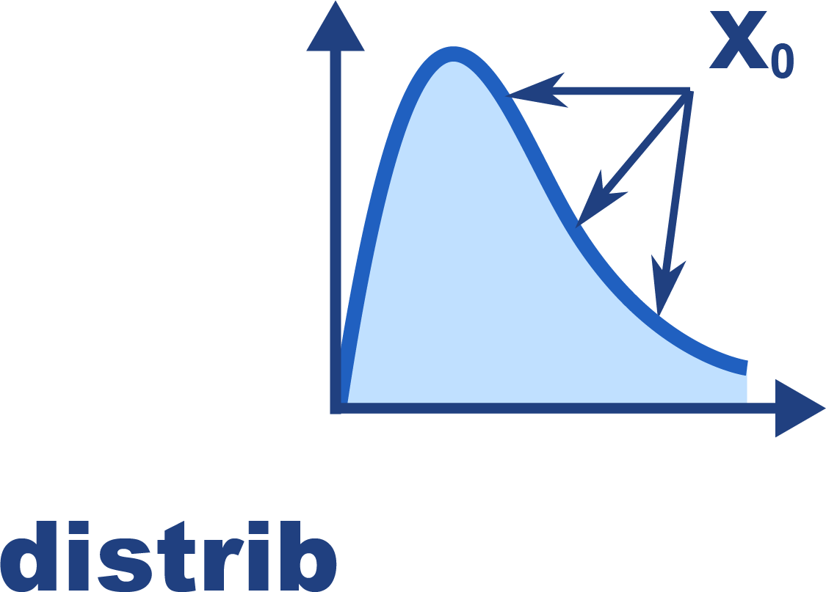

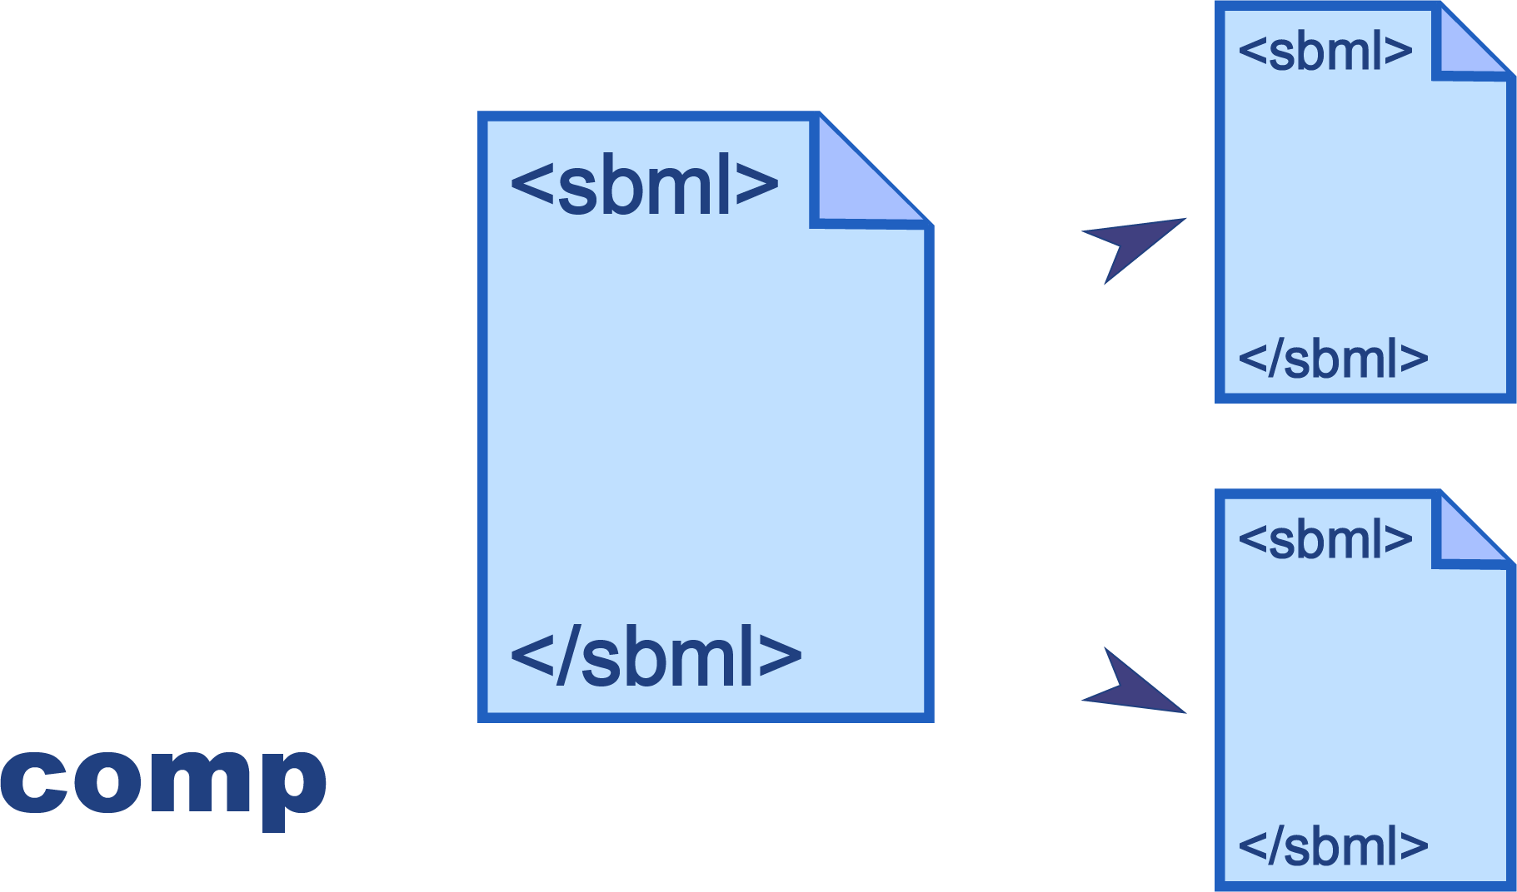
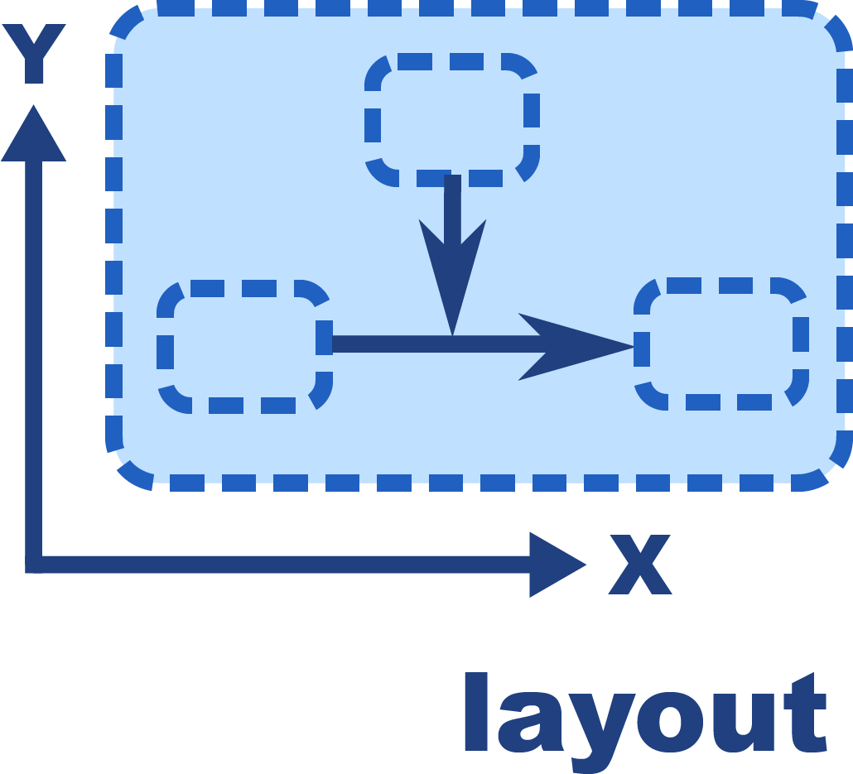
What is sbmlutils?
Collection of python utilities for working with SBML models https://github.com/matthiaskoenig/sbmlutils/ https://sbmlutils.readthedocs.io
Features
model creation, manipulation & merging
unit support
model annotation
model reports
interpolations
file converters (XPP)
Packages
core, fbc, comp, distrib, layout

Slide 3
sbmlsim
Python utilities for simulating SBML

Slide 4
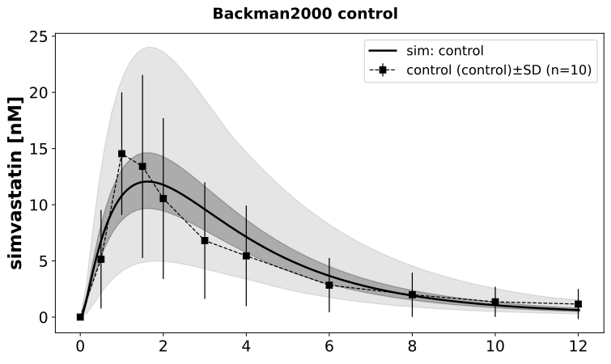
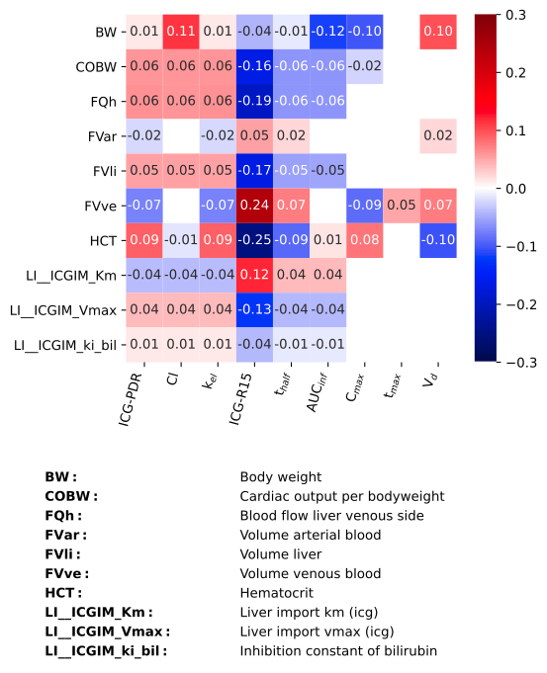
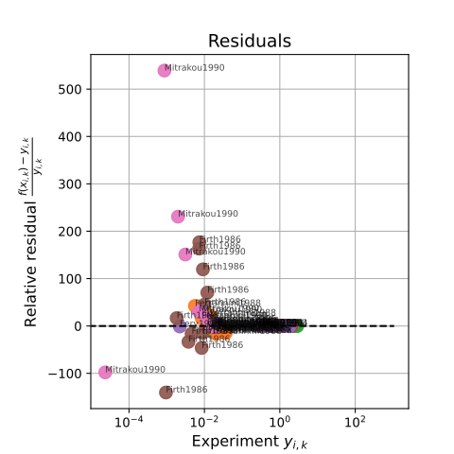
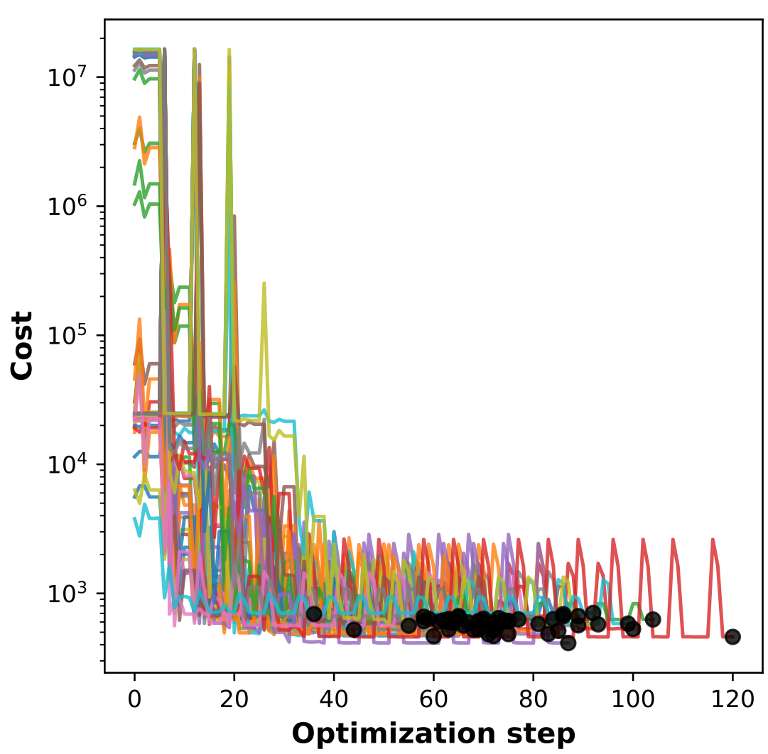
What is sbmlsim?
Collection of python utilities for simulating SBML models (ODE) https://github.com/matthiaskoenig/sbmlsim https://sbmlsim.readthedocs.io
Features
model simulation
data support
unit support (& conversion)
multi-core execution (ray)
simulation experiments (publications)
parameter scans
parameter fitting

